Slide 1
Differentially Private K-means Clustering
Mohammad Albejadi | 201582510
Faris Hijazi | 201578750

Slide 2
Outline
Introduction
Objective
Theory
Implementation
Results
Conclusion

Slide 3
Introduction
K-Means clustering is a technique to partition n nodes into k clusters
Reduce distance between node and mean of cluster
Optimal k clusters
Heavily used for data analysis
Used in Internet of Things (IoT) devices and Wireless Sensor Network (WSN)
Nodes can be personal data, location, research data
Privacy can be critical

Slide 4
Objective
Our objective in this project is the following:
1- Implement a differentially private k-means clustering technique
2- Verify the results of our implementation by comparing it to a normal k-means clustering results and evaluating using metrics

Slide 5
Theory
Our implementation is based on a published paper* where differential privacy is used to preserve the data privacy by adding noise to both the mean of each cluster and the number of nodes in each cluster
The steps of the technique is as following:
1- Equally divide all nodes into k clusters
2- Calculate the sum of the data (sum) and the number of the nodes (num) in each cluster, add random noise to both of them and calculate the mean of each center (sum/num)
3- Calculate the contour coefficient (S) for each cluster and calculate the noise to add
* https://journals.plos.org/plosone/article?id=10.1371/journal.pone.0206832

Slide 6
Theory
Where
and t is the number of iteration
And then the noise is added to both the sum and num of each cluster and the mean is recalculated
4- Redistribute the nodes based on the new means. Calculate the sum and num and check stop conditions:
Max iterations
Min error
Go back to step 3 if not done
Notes:
-

Slide 7


Theory
Where ai is the average distance from node i to every other node in the same cluster
And bi is the minimum average distance from node i to every other node in other clusters

Slide 8
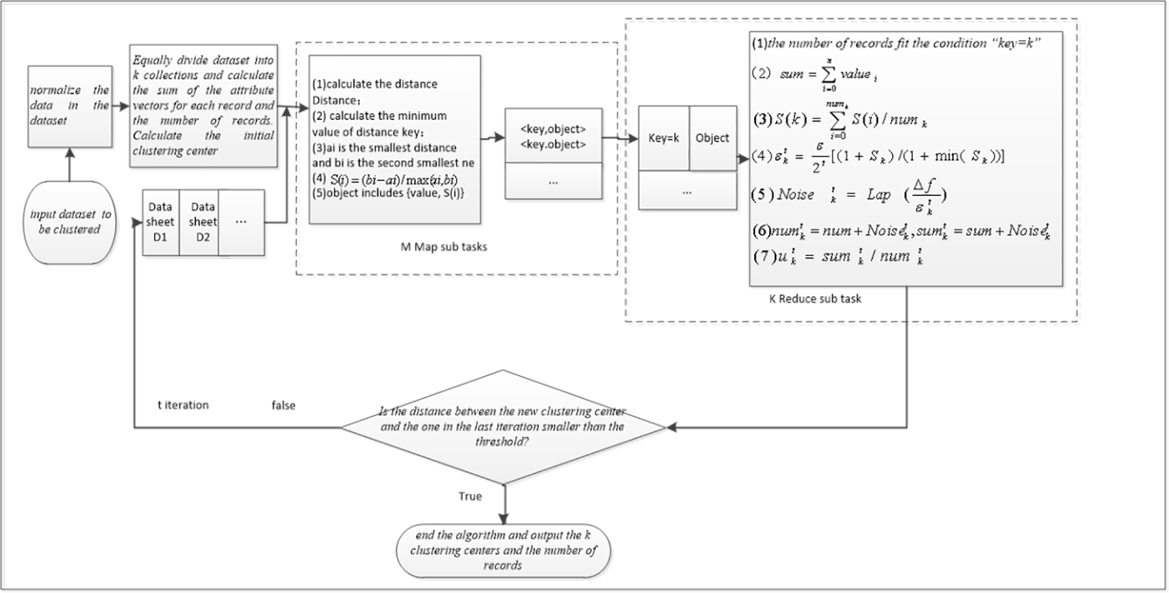
Implementation

Slide 9
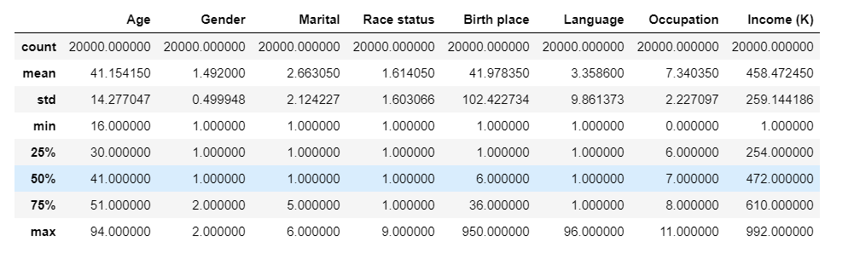
The Data
Notes:
Talk about the data:
Used the ipums data set which has 8 features
Ran the algo with different number of featuers, ran with all features and with 3 featuers (easy to represent)

Slide 10
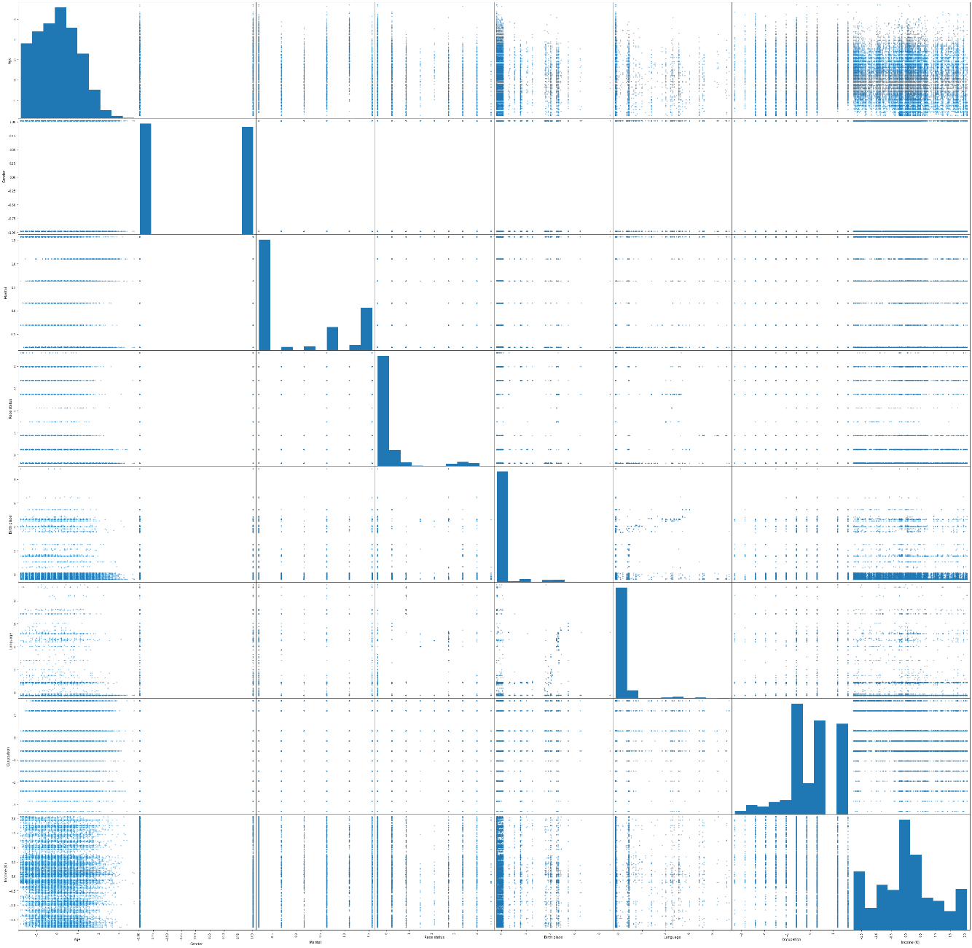
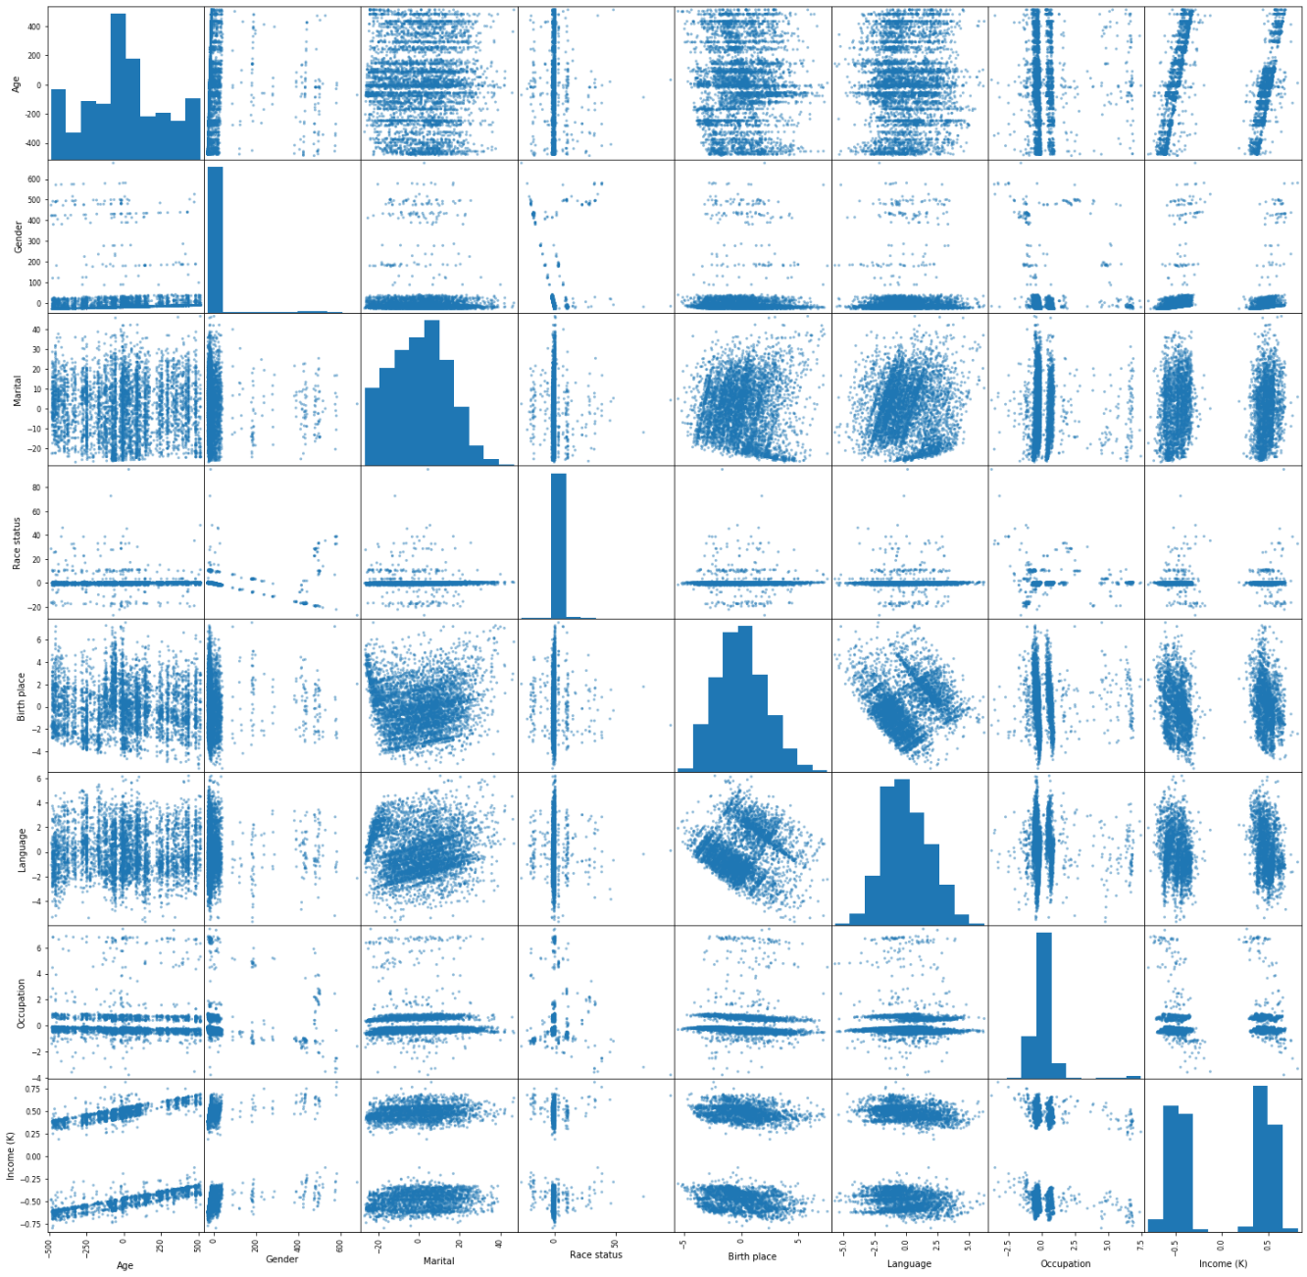
Preprocessing Principle Component Analyses (PCA)
Without PCA
After PCA transform
Notes:
PCA principle component analyses
Scatter matrices
PCA also normalizes the data (mean 0, var 1)

Slide 11
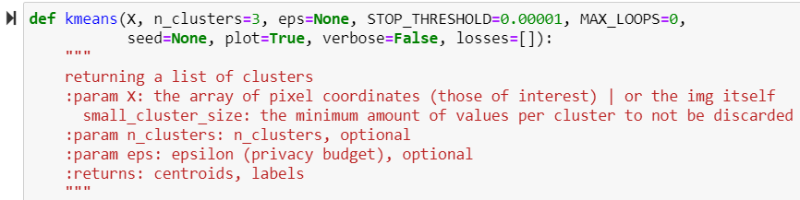
Tools: python jupyter notebook

Slide 12
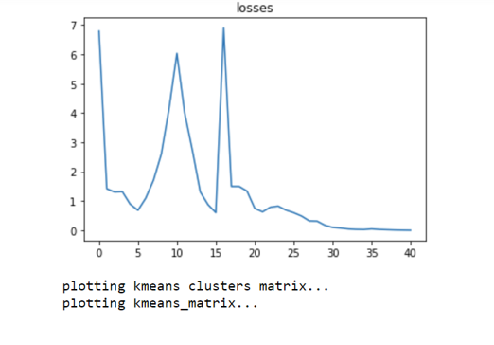
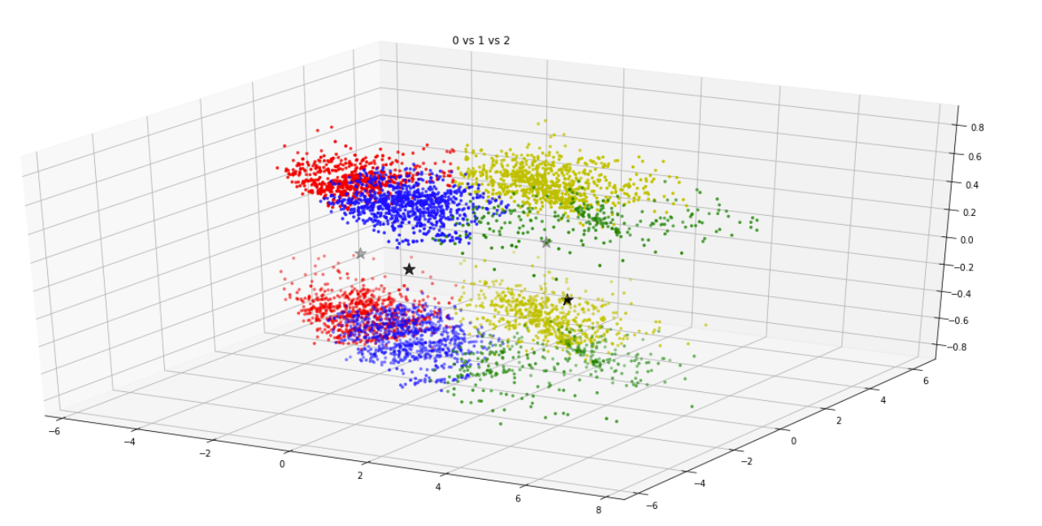
Output
K=4
Notes:
Spike cuz of nan

Slide 13
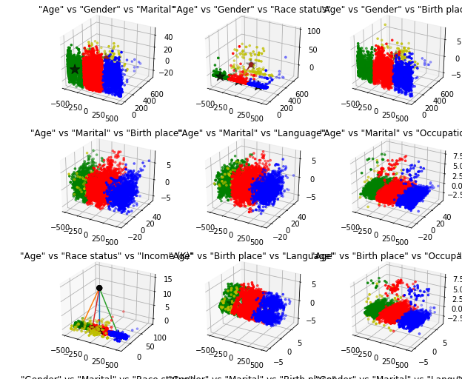
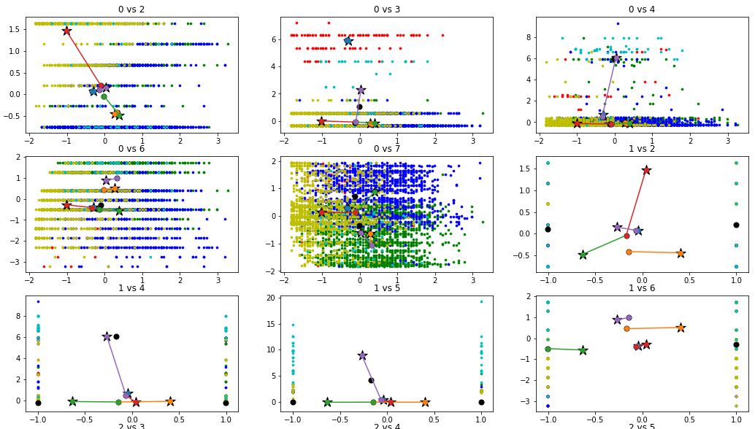
Results – representing the difference
Comparing DP_kmeans and normal kmeans
K=4
Notes:
Not sure if the changes are actually correct, but I’m showing it cuz it looks cool

Slide 14
Performance and evaluation

Slide 15
Results
Comparing DP_kmeans and normal kmeans
huge performance difference (1000x times slower)
DP: 38.3s vs reg: 525ms
Does cluster successfully (although with lower accuracy)

Slide 16
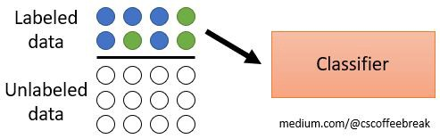
Labeled vs Unlabeled data

Slide 17
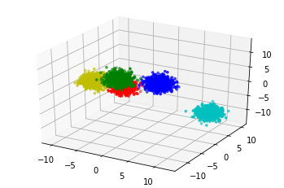


Performance
How to score an unlabeled dataset?
Davies Bouldin score (works when labels are not known) (0 is best):
Reg: 0.53
DP: 29.4
Generate labeled data (blobs)
Notes:
They seem to both be getting the same score so I’m very skeptical
TOFIX:
- seed should be incremented
-

Slide 18
Conclusion
The implemented technique preserve the privacy of the data by producing a differentially private result, which introduces an obstacle to any attempt of exposing additional information about the nodes

